Slide 1


K.K WAGH INSTITUTE OF ENGINEERING EDUCATION AND RESEARCH Department of Information Technology
“Low Light Image Enhancement for Dark Images”
By
Tejas Chaudhari(71704582L)
Akshay Patil(71704980K)
Ketan Deo(71704616J)
Kalpesh Sonawane(71705184G)
Guide
“Prof. R. M. BORA”
Day and Date of Review : Thursday, 12 December 2019

Slide 2
Contents
Abstract
Problem Statement
Objective and Scope
Literature Survey
What is Exclusively Dark Dataset?
ExDark Dataset Statistics
Techniques
Block Diagram
Use Case Diagram
Activity Diagram
Requirements
Application
Advantages
Conclusion
Reference

Slide 3
Abstract
Image plays an important role in this present technological world and leads to progress in multimedia communication, various research fields related to image processing, etc. Low-light image enhancement specifically addresses images captured in low-light conditions such as nighttime, where the common goal is to brighten and improve the contrast of the image for better visual quality and show details that are hidden in darkness. To improve image quality, these low-light images are needed to be enhanced. For this purpose, an exclusively dark dataset comprising of images captured in visible light only is proposed. Further, dehazing technique is used for haze removal, histogram equalization (HE) technique is used for contrast enhancement and denoising technique is used for noise removal. Experimental results demonstrate that the proposed method achieves a good performance in low light image enhancement and outperforms state-of-the-art ones in terms of contrast enhancement and noise reduction.

Slide 4
Problem statement
To propose a Low Light Image enhancement technique that is able to provide solutions for dark images, fixing it and to find the proper solution.

Slide 5
Objectives and Scope
To facilitate a better understanding of the low-light phenomenon focusing on objects using the proposed Exclusively Dark Dataset.
An object focused analysis of low light image using the state of art algorithms in both hand-crafted and learned features for a better understanding of low-light vision and its difference from vision with sufficient illumination.
Scope:
Enhancement of low-light images using Dehazing, Histogram Equalization and Denoising techniques.

Slide 6
Literature Survey
H. Malm, M. Oskarsson, E. Warrant proposed a low light image enhancement algorithm based on adaptive spatiotemporal smoothing and contrast limited histogram equalization to reduce noise and expand the dynamic range of low light images.
Dr. Gregory Luppescu and Dr. Raj Shah of Standford University worked on this project of enhancement. They worked on histogram equalization and Gamma correction techniques.
H. Bayer proposed Bayer patterns for denoising the image

Slide 7
What is Exclusively Dark Dataset?
The Exclusively dark(Ex Dark)dataset is a collection of 7,363 low light images
This ExDark Dataset is taken from very low light environment to Twilight(i.e 10 different conditions)with 12 object classes .
PASCAL VOC, Image Net and Microsoft COCO has a kind of dark dataset for processing
PASCAL VOC has 26,305 images with 20 object classes
Image Net was open to public and it gained about 1 million images and over 1000 object classes
Microsoft COCO has 353 images with 12 object classes

Slide 8
ExDark Dataset Statistics
The dataset currently has 7,363 images with 12 object classes Bicycle, Boat, Bottle, Bus, Car, Cat, Chair, Cup, Dog, Motorbike, People and Table

Slide 9
Techniques
Dehazing
Histogram Equalization
Denoising

Slide 10
Dehazing
Image dehazing refers to procedures that attempt to remove the haze amount in a hazy image and grant the degraded image an overall sharpened appearance to obtain a clearer visibility and smooth image.
Light reflected due to haze has a particular colour: the colour of ambient light that is reflecting. This colour should be fairly constant over the whole picture, so when we calculate it we just remove that constant value from every pixel.

Slide 11
Steps for Dehazing
Select an image with haze.
Invert the selected image.
Reduce the atmospheric haze.
Again invert the image to see original image with haze reduced.

Slide 12
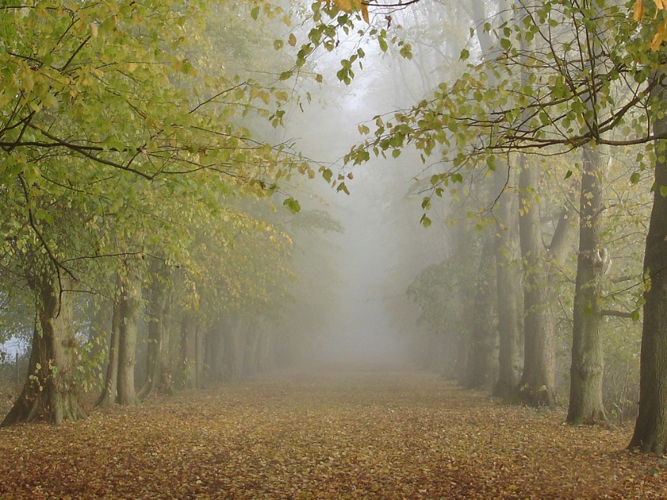
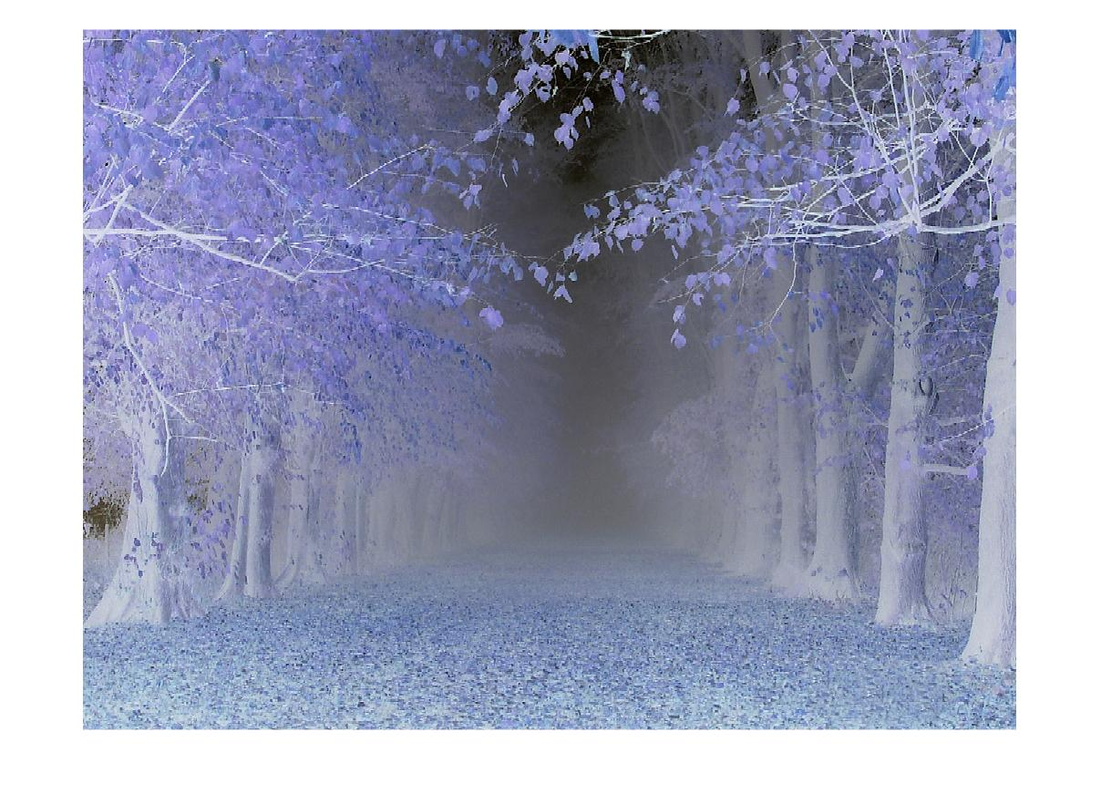
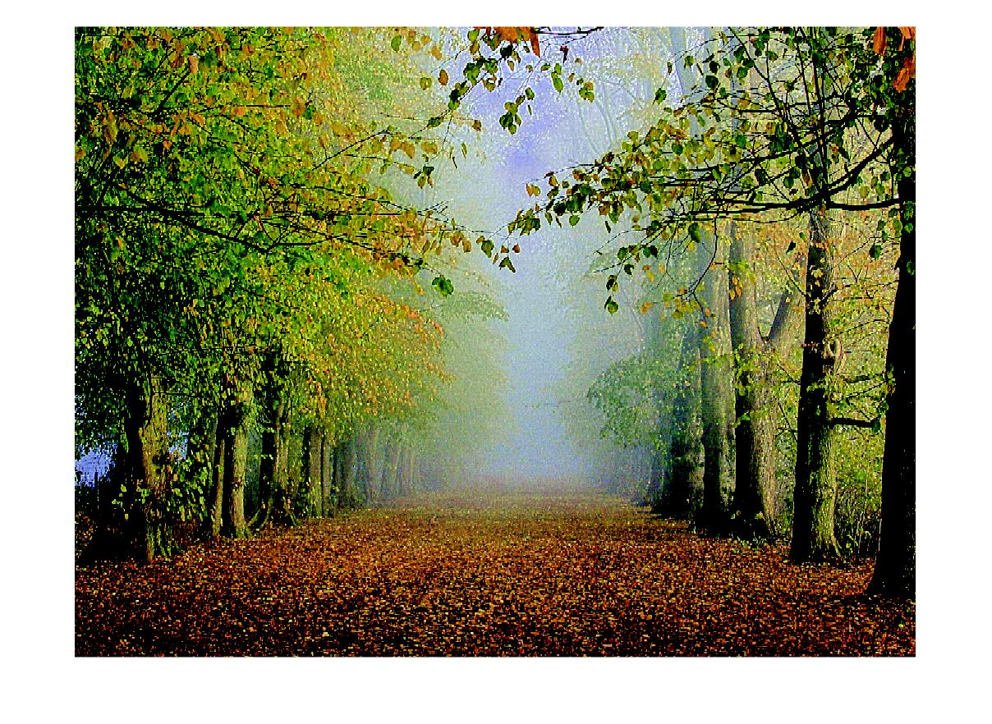
1. Original Image
2. Inverted Image
3. Dehazed Image

Slide 13
Histogram Equalization
Histogram Equalization is one of the fundamental tools in the image processing toolkit.
It is a technique for adjusting the pixel values in an image to enhance the contrast by making those intensities more equal across the board.

Slide 14
Steps for Histogram Equalization
Select an image for Histogram Equalization.
Apply Histogram Equalization on the selected image using the histeq() function.
Display the resultant image.

Slide 15
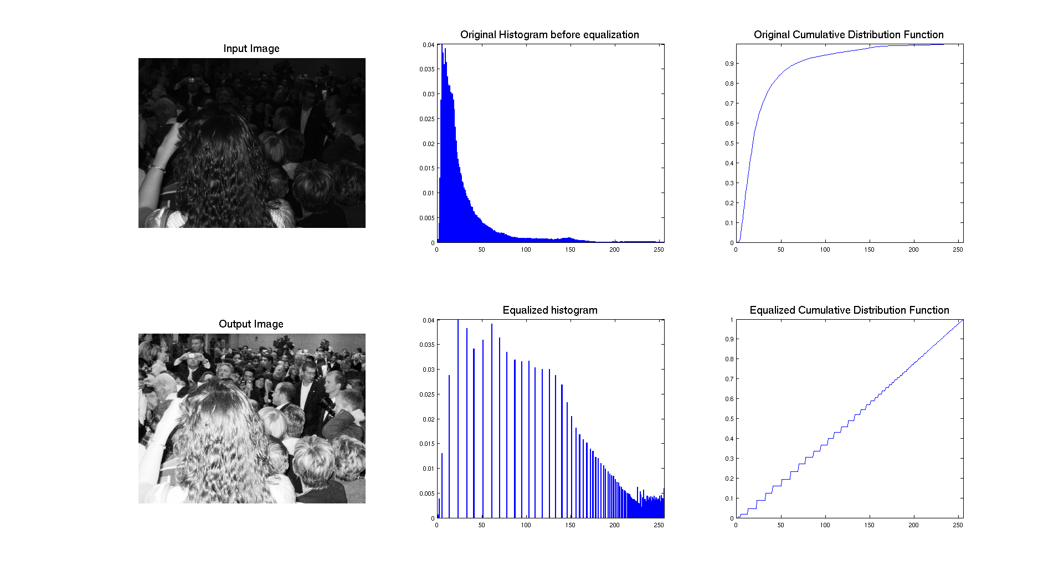

Slide 16
Denoising
Image de-noising is a process of removal of unwanted disturbances from the image making image interpretation and analysis easier.
The process of image de-noising is achieved by filtering the unwanted noise and accentuating the features and quality of an image.

Slide 17
Steps for Denoising
Select an image to remove noise.
Apply median filtering techniques:
redChannel = p(:, :, 1);
Median Filter the channels:
redMF = medfilt2(redChannel, [3 3]);
Concatenate all 3 channels:
rgbFixed = cat(3, redMF, greenMF, blueMF);
Display the output image.

Slide 18
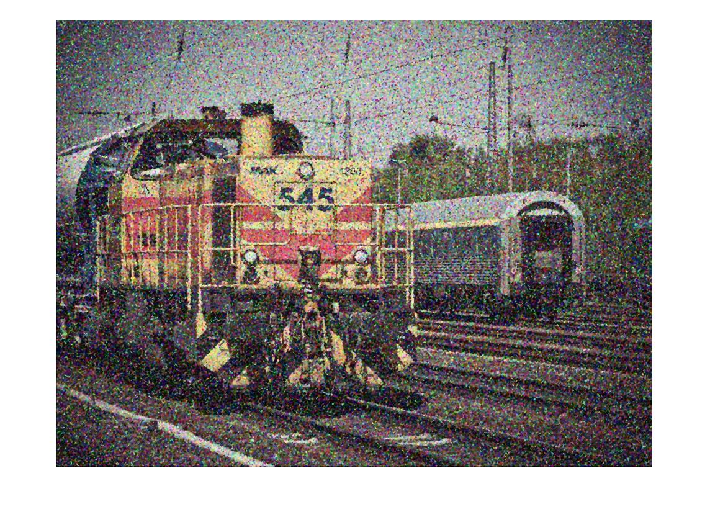
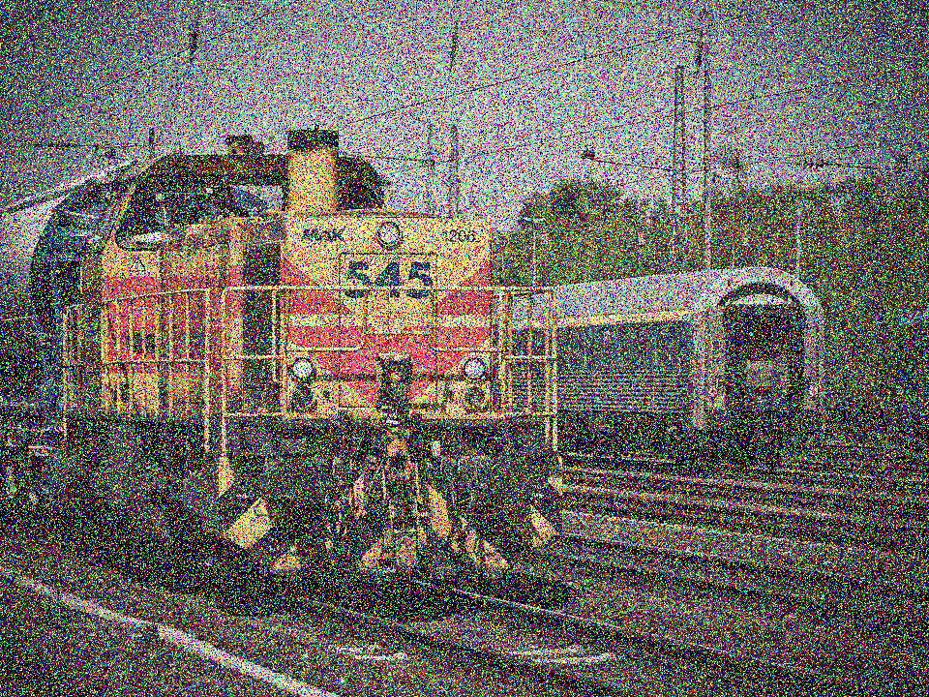
Original image with noise
Image with noise removed

Slide 19
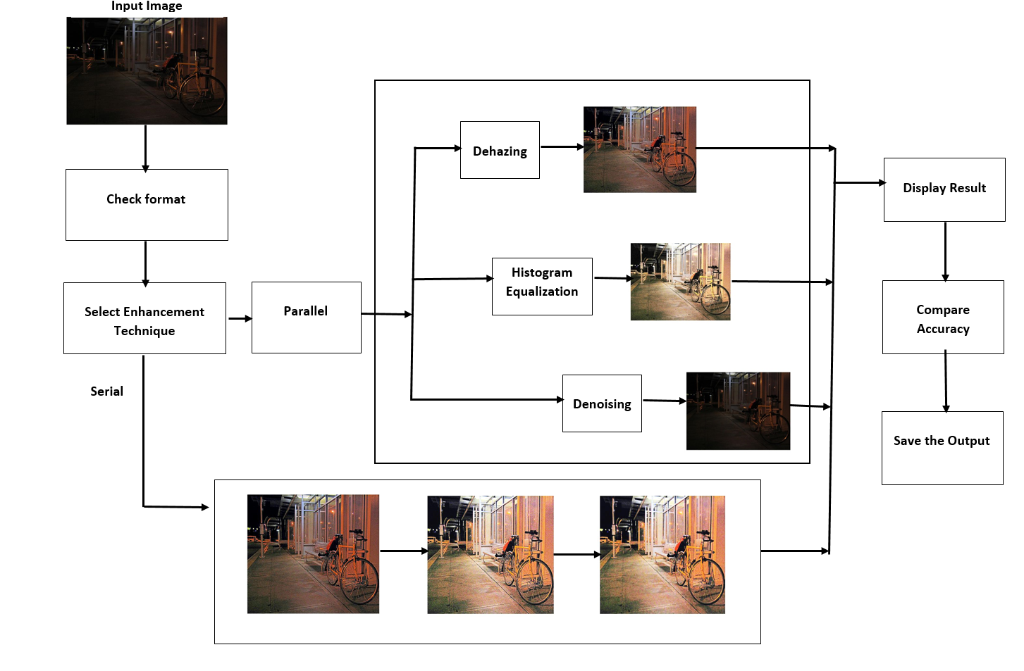
Block Diagram

Slide 20
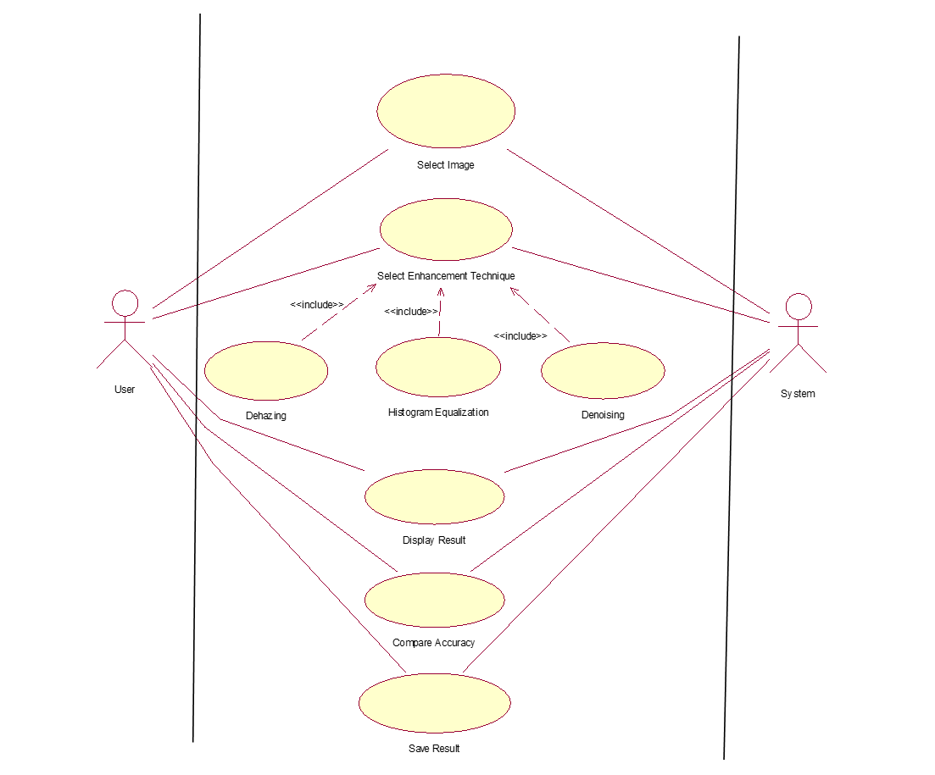
Use Case Diagram

Slide 21
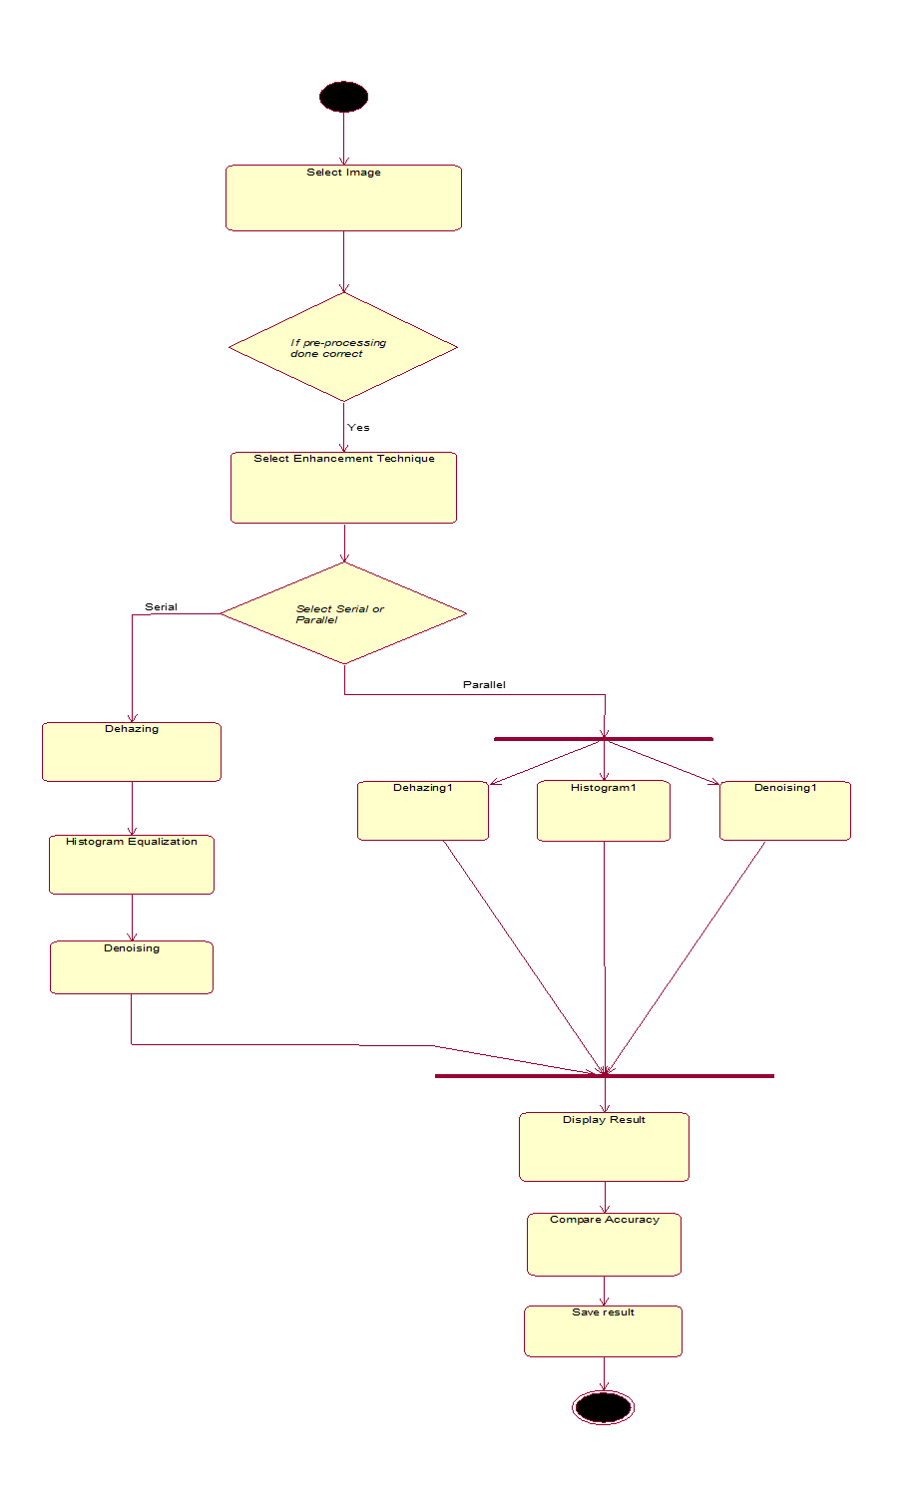
Activity Diagram

Slide 22
Requirements
Requirements:
Hardware: Computer System
Software: Matlab, Python (Enthought Canopy)

Slide 23
Application
• Security
• Medical
• Satellite Images

Slide 24
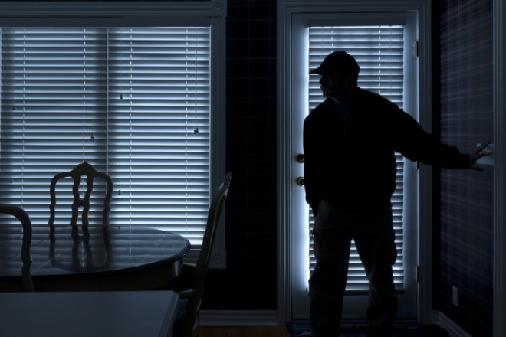
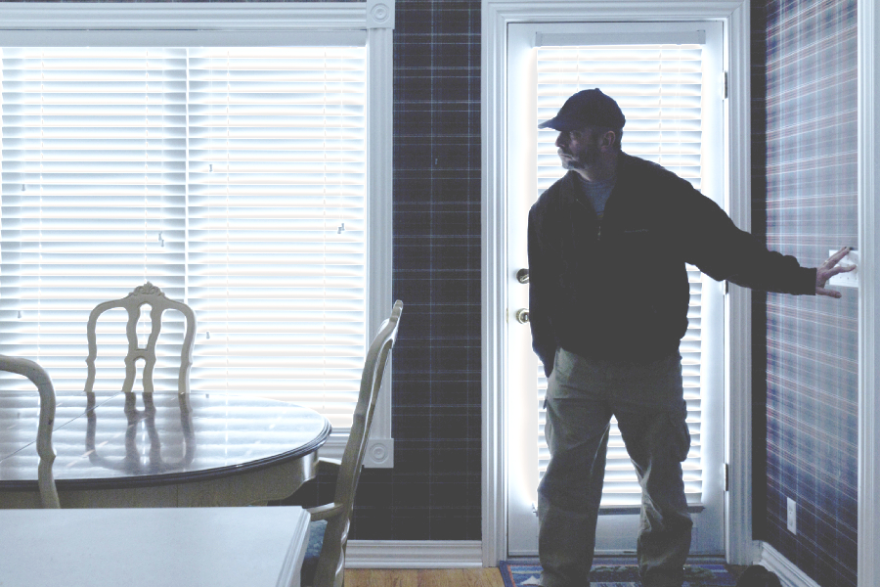
Security

Slide 25
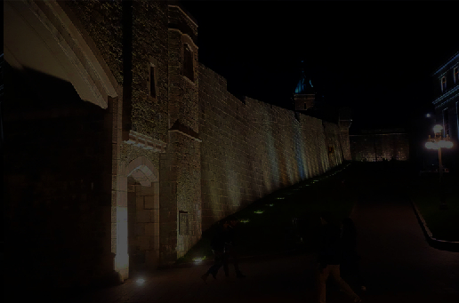
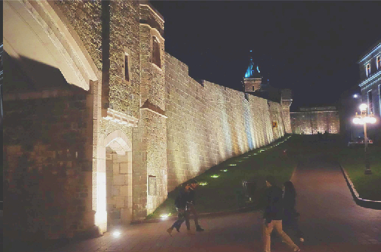
Security

Slide 26
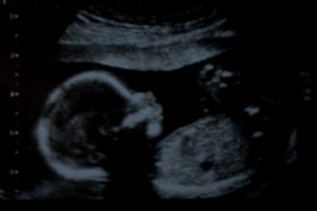
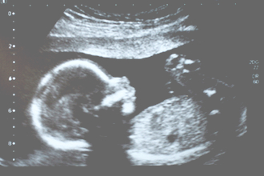
Medical

Slide 27
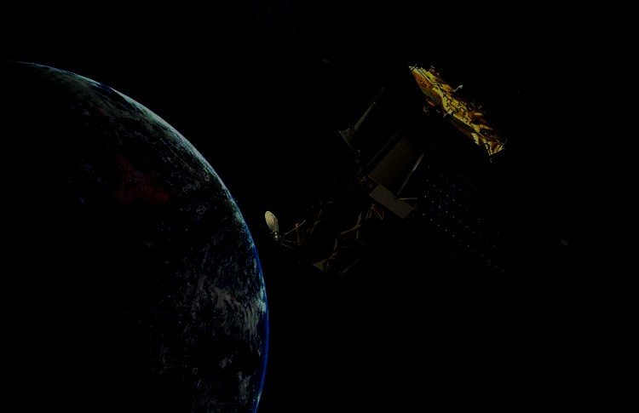
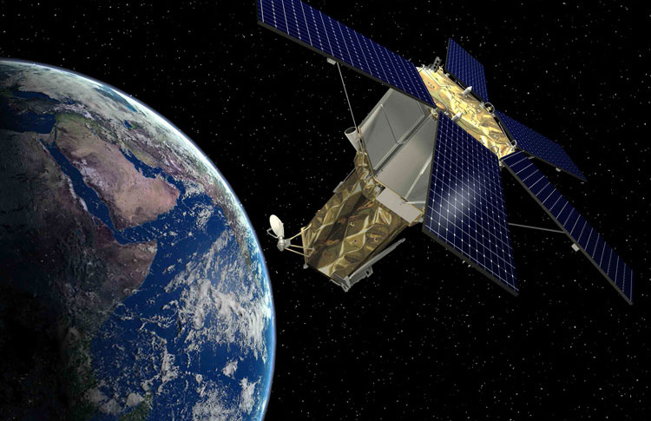
Satellite Images

Slide 28
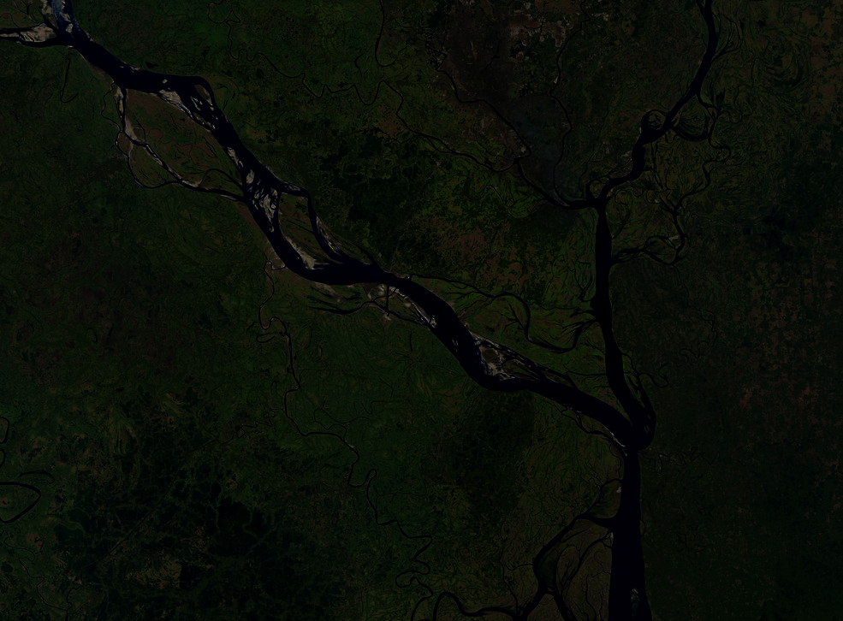
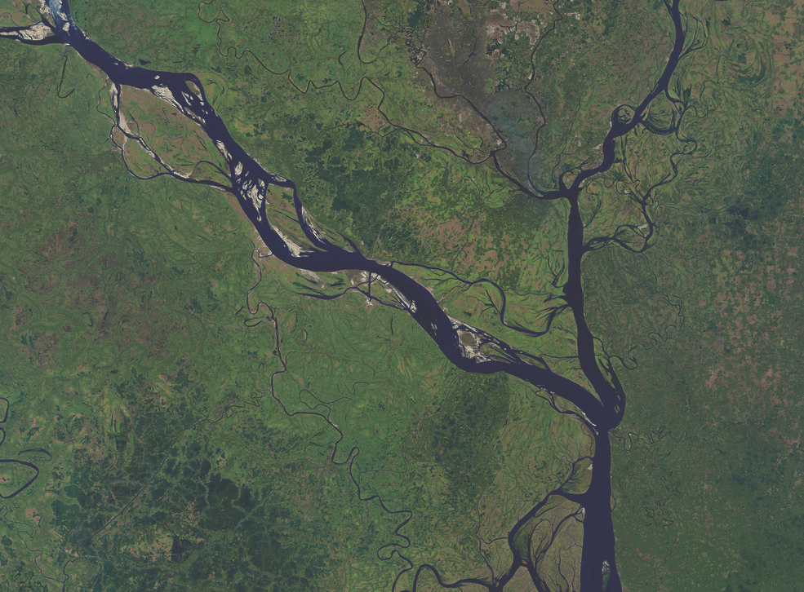
Satellite Images

Slide 29
Advantages
• Image processing made digital image can be noise free
• It can be made available in any desired format.
• This method is useful in image with background and foreground that are both bright and dark

Slide 30
Conclusions
In this project we studied what is dark dataset, problems causing dark images, techniques to remove the problems and finally obtaining the proper image.
This study has found that generally the proposed scheme, successfully extracts the necessary information from an image, by illuminating the dark regions, without causing artifacts or saturation effects.

Slide 31
References
Chen, C., Chen, Q., Xu, J., Koltun, V., 2018. Learning to see in the dark. In: Computer Vision and Pattern Recognition (CVPR), 2018 IEEE Conference on.
Guo, X., Li, Y., Ling, H., 2017. Lime: Low-light image enhancement via illumination map estimation. IEEE Trans. Image Process. 26, 982–993.
Jung, C., Yang, Q., Sun, T., Fu, Q., Song, H., 2017. Low light image enhancement with dual-tree complex wavelet transform. J. Vis. Commun. Image Represent. 42, 28–36.
Li, M., Liu, J., Yang, W., Sun, X., Guo, Z., 2018. Structure-revealing low-light image enhancement via robust retinex model. IEEE Trans. Image Process. 27, 2828–2841.

Slide 32
Thank You!!
Any Questions?

